Slide 1


Analysis of Olympics Data
By - Vineet Kapoor(11910076)
ISB CBA Practicum
23rd September , 2018

Slide 2
Table Of Contents
Executive Summary
Business Problem
Introduction
Motivation For Study
Methodology & Tools
Models
Message
Means
Analytics Approach
Connecting CBA Term – 2 courses
Data collection & cleaning
Data Understanding
Data Preparation
Analysis & Results

Slide 3
Data Preparation
Data Understanding
Modelling & Evaluation
Business Recommendation
Assumptions, Limitations.
References.

Slide 4
Executive Summary
There exist a strong correlation between Olympics performance with Nominal GDP, Number of internet users, country is host or not.
Gender Gap index and Population of a country is correlated to some extent with the count of total medals.
Countries like US bag more medals in Swimming due to height of their players.
Nominal GDP is responsible for good performance of Russia , Australia, Germany, Great Britain and France in Olympics
China’s population and it’s sports culture, sports schools, sports trainees are responsible for it’s good performance.

Slide 5
Methodology and Tools
Step 1
Step 2
Step 3
The data has been filtered out for only those players , who have won medals in the original given dataset. The data is cleaned and all the missing values has been imputed. An additional data using GDP , population and total number of medals was also used for clustering and analysis is performed.
The Dataset for regression has been taken from Wikipedia, economic freedom index site, World Bank, Gender gap index.
Data was collected for top 20 countries in 2016 summer Olympics and India also.
Two datasets are used for analysis. The dataset used for clustering was cleaned. Missing values were imputed by their mean values. Dataset used for Regression analysis is created using the information from the Wikipedia and sites. Total number of medals for top 20 countries in Olympics 2020 are predicted
Step 4
Step 5
Step 6
K- Means Clustering has been performed on the age, weight and height variables for summer and winter seasons. and on whole data
K- Means Clustering has been performed on the age, weight and height variables
Methods used for performing regression models are
Ordinary Least Squares
2. Random Forest.
Gradient Boosting Regressor
K Nearest Neighbours regressor.
Optimization of Hyperparameters is also performed.
The training and validation data was created using sampling and K- fold cross validation. The whole modelling exercise is done on python using sklearn package.

Slide 6
Infographic Style
Add Title
Add Title
Add Title
Add Title
You can simply impress your audience and add a unique zing and appeal to your Presentations. Easy to change colors, photos and Text.
You can simply impress your audience and add a unique zing and appeal to your Presentations. Easy to change colors, photos and Text.
You can simply impress your audience and add a unique zing and appeal to your Presentations. Easy to change colors, photos and Text.
You can simply impress your audience and add a unique zing and appeal to your Presentations. Easy to change colors, photos and Text.
$233,000
$433,000
$653,000
$822,000

Slide 7
Business Problem
Which countries dominate in Olympics and why?
To Analyse different countries on the basis of Age, Height and Weight. of players, who won the medals for all seasons
To Cluster different countries on the basis of Age, Height and Weight. of players, who won the medals for Summer and Winter seasons.
To Cluster different countries on the basis of GDP, population and total medals.
Identify the factors that are driving India behind other countries.
Predicting the rank or performance of top 20 countries in next Olympics.
Forecasting the number of gold medals

Slide 8
Introduction

Slide 9
Motivation For Study
The prediction of total medals from regression and other models can be used for building a predictive model . The K- fold cross validation and comparison of RMSE can improve the accuracy of the model.
The K – means clustering of the GDP , population and number of medals will help to find out the relation of GDP, population with the performance of countries in Olympics.
The K – means clustering of the Age, Height and weight for Summer and winter seasons can help to find the comparison between genes of Olympic athletes in top countries.
Regression analysis will provide the further insights.

Slide 10
Analytic Approach
Check for correlation between different variables
Check for factors responsible for predicting total count of medals.
To forecast the number of Gold medals for countries -
To build a Multiple Regression Model using different techniques and evaluating the models using RMSE, LRMSE.
To build clusters of observations using GDP, population, total medals data using K-means algorithm.
Analyse the top 20 athletes, top 10 male and female athletes.
Analyse mean height of players for all countries , who won at least one medal.

Slide 11
Models
Multiple Regression Model
GBM – Gradient Boosting Regressor model
KNN regressor model
Random Forest model
Hyperparameter tuning
K- Means clustering method

Slide 12
Questions & Hypothesis
Following are some of the key questions/ hypothesis that we would like to answer/ test:
Perform ANOVA Hypothesis testing between top four cryptocurrencies

Slide 13
Message
Blockchain is the factor responsible for Cryptocurrencies growth and decline.
Ethereum is the currency, which can be used for investment, as it’s average daily returns are better than other three cryptocurrencies – Bitcoin, Bitcoin – cash, ripple.
The pattern of twitter sentiments is similar in US and India, the pattern is like overall sentiment. Japan has a different pattern of sentiments.
Bitcoin is the currency used for most of the transactions.
There is high correlation between bitcoin and Ethereum close price.
The forecast of close price of Bitcoin and Ripple shows that the prices will decline.
Proportion of neutral and positive sentiments from news articles and blogs are almost similar and greater than negative sentiments.

Slide 14
Means
Visualization Tools - Tableau, Python, R.
Modelling Tools – OLS model, K-means model, Lasso Regression model, Elastic Net model packages from sklearn are used.
R studio - K-means clustering is performed in R studio.
Python – Regression analysis is performed in Python.
Libraries used – in R: ggplot2, forecast, zoo, cluster, factoextra, magrittr, dplyr,
In Python: numpy, pandas, matplotlib, seaborn, StandardScaler, statsmodels.formula.api.

Slide 15
Connecting CBA Term – 2 courses
K- means Clustering, PCA, Multiple Regression , Evaluation of Models and optimizing the Hyperparameters, Forecasting.

Slide 16
Data collection & cleaning
Olympics medals Wikipedia
Economic Freedom Index
Number of internet users
GDP (NOMINAL & PER CAPITA)
Population

Slide 17
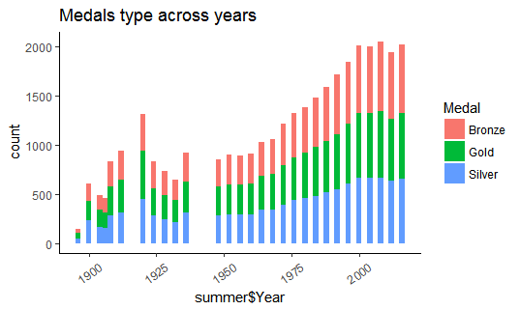
Data Understanding - Analysis & results:

Slide 18
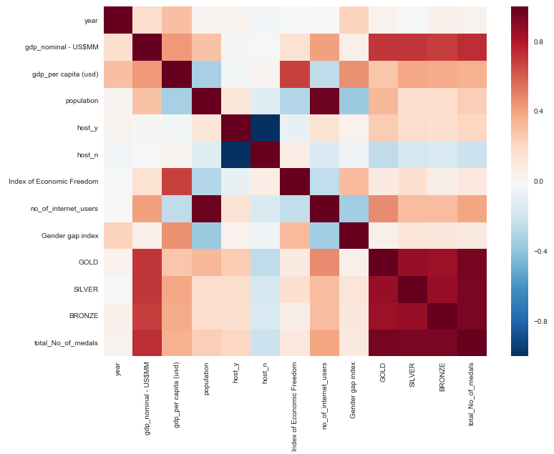
Correlation between top 4 cryptocurrencies. There is high correlation between bitcoin and ethereum.

Slide 19

Histogram of close prices of all the four cryptocurrencies. All of them are following a standard normal curve

Slide 20
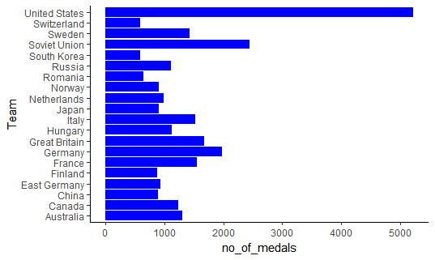
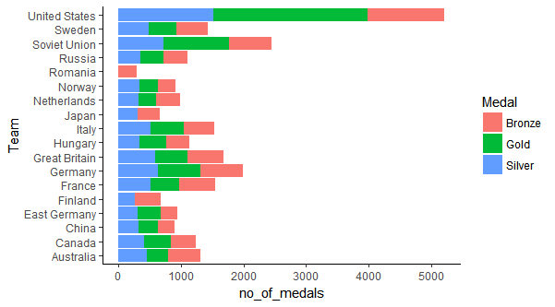

Slide 21
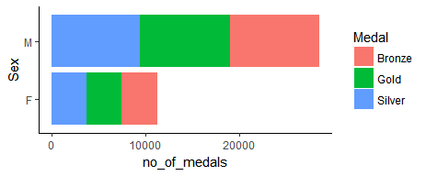
Only for one day, the frequency of Ethereum tweets saw an outlier, except that, the average frequency is 1.53 is the average daily number of tweets.
asa

Slide 22
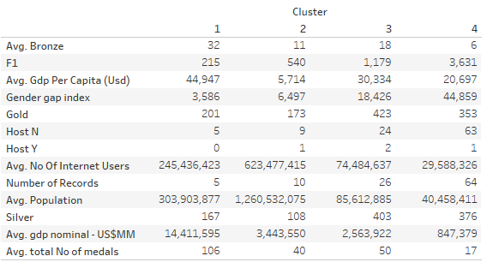
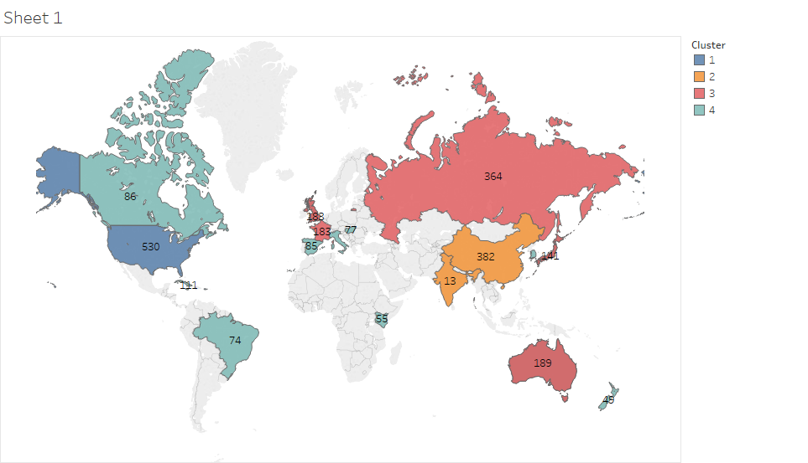
Clustering Countries using GDP-nominal, total medals and population.

Slide 23
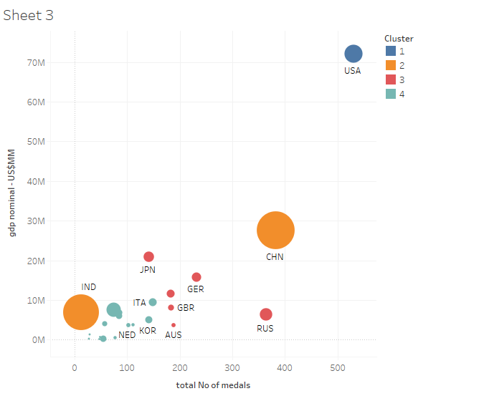
Followers engagement with bitcoin is decreasing after first first week of June month. In may month, the number of followers were more than 200 many times as compared to June month. For last 30 days.

Slide 24
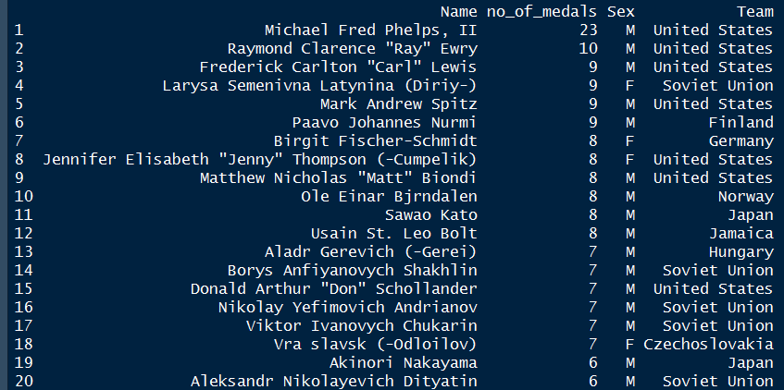
Followers engagement of Ethereum currency are is more at the end of the year 2017. The retweets have increased in 2018 relative to 2017.

Slide 25
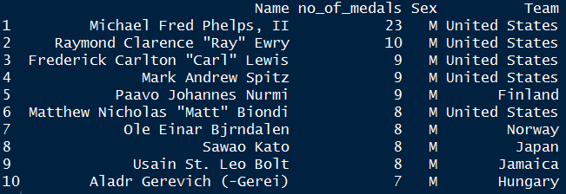
Wordcloud of tweets from Bitcoin time line. Most of the words are related to money, block, transaction, system, video, network.

Slide 26
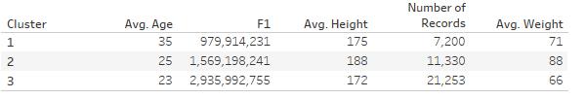
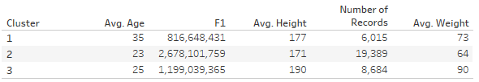
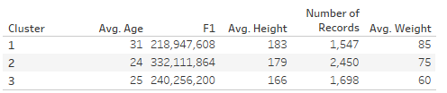

Slide 27
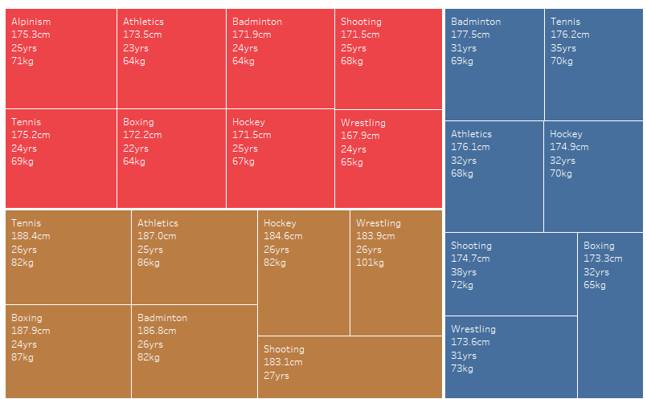

The sentiments are almost neutral. There is not clear pattern of negative and positive sentiments using …. Dictionary.

Slide 28
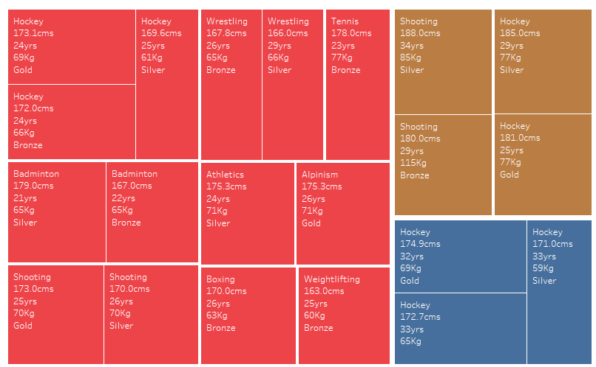

Slide 29
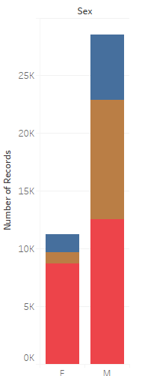
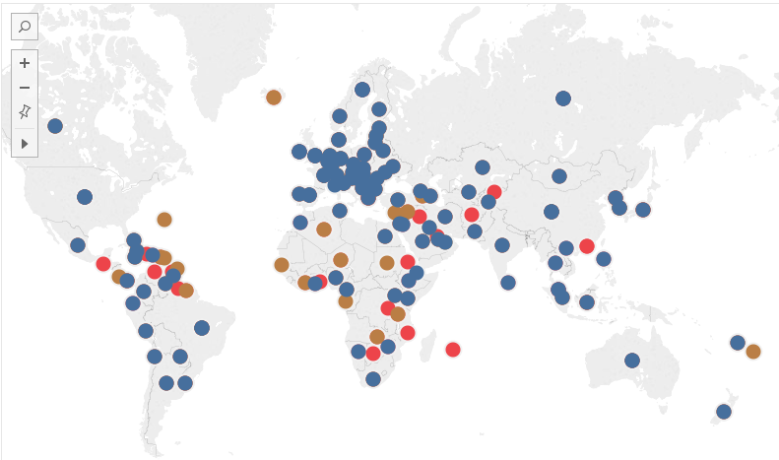

Slide 30
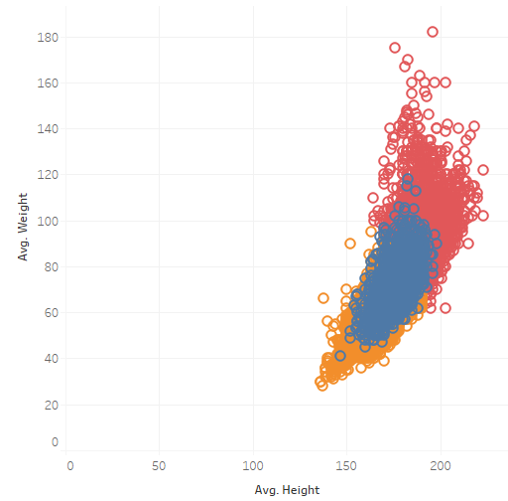

Slide 31
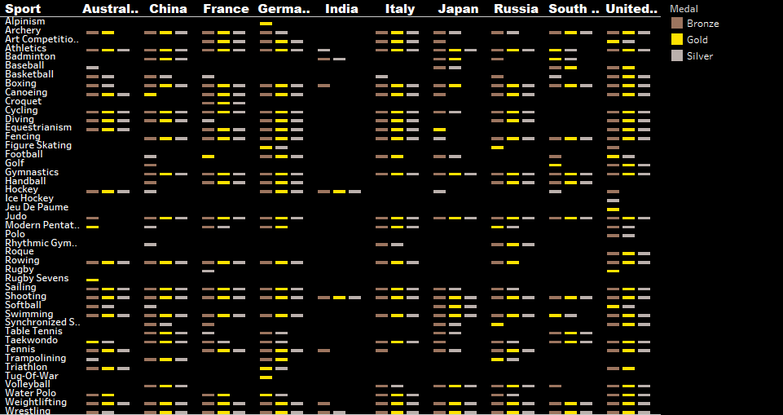

Slide 32
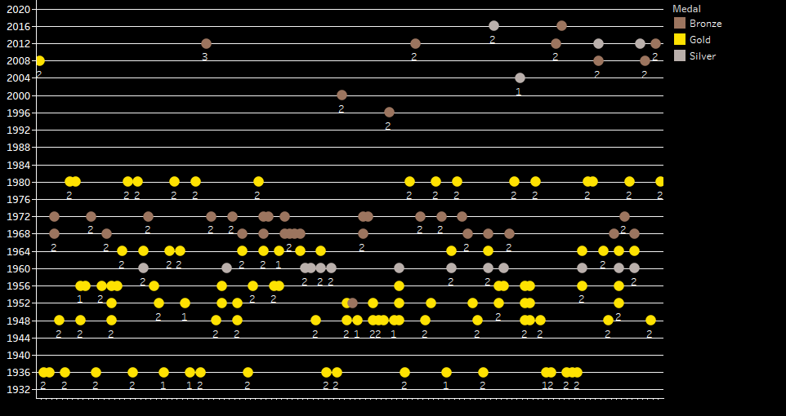

Slide 34
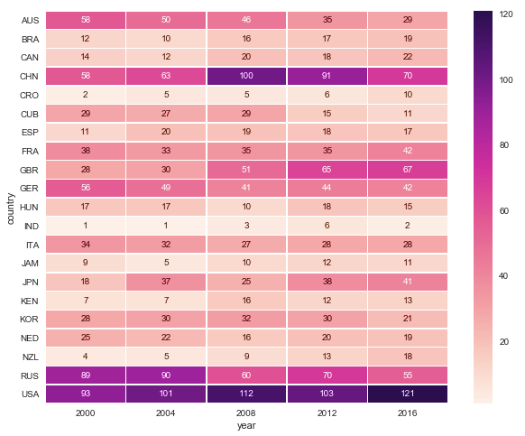

Slide 35
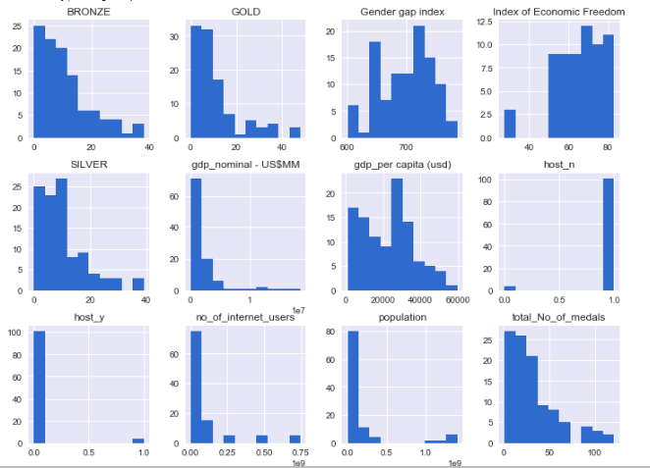

Slide 36
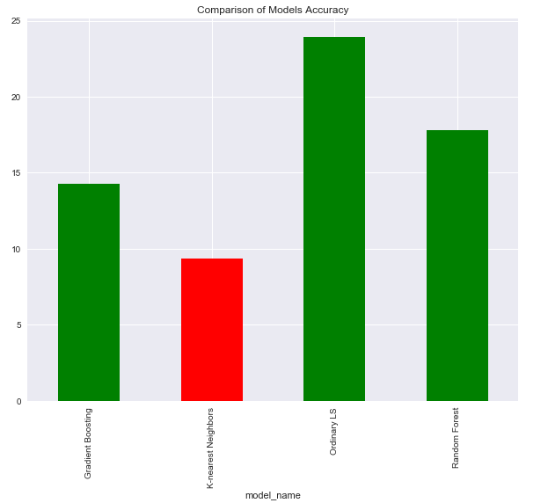
Comparison of live tweets of Cryptocurrency and Bitcoin

Slide 37
Most Joyful words occurred in corpus.
Most fearful words occurred in the corpus.
Word <chr> | n <int>
Cash | 75
Money | 29
Pay | 10
exciting | 9
excited | 7
Good | 7
Word | n
Cash | 75
lightning | 13
Watch | 13
Change | 7
government | 6
.

Slide 38
Words like sorry, hard, congestion, issue, attacks are occurring most in negative sentiments. Words like thank, right, welcome, cool, exciting, most of the words are sentiment words in cryptocurrency corpus.

Slide 39
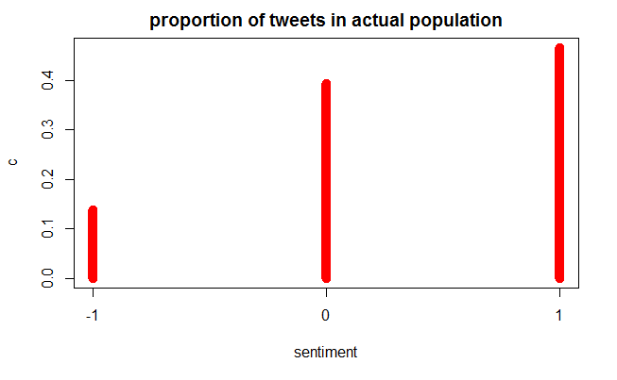
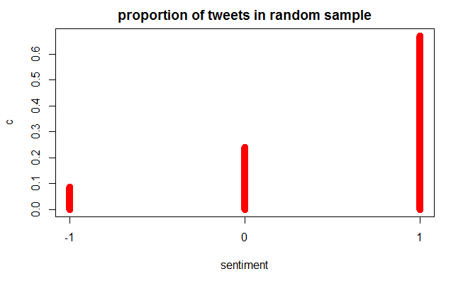
Comparison of predicted sentiments with actual population of sentiments of Bitcoin. Sentiments of Tweets of Bitcoin were taken as training data and sentiments of tweets of Cryptocurrency were predicted

Slide 40
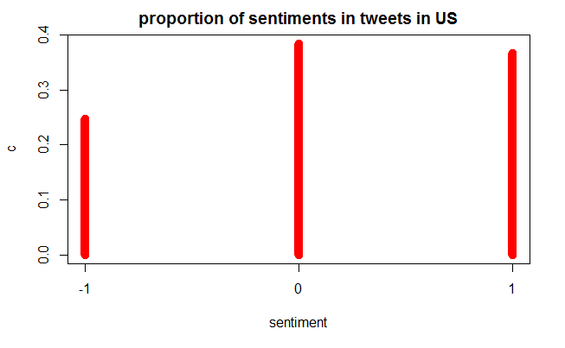
Regional wise analysis of Cryptocurrency
Proportion of sentiments of tweets of Bitcoin in US - Neutral and Positive tweets are almost equal. The negative tweets are 25% of the total tweets. The sentiment is diverse.

Slide 41
Modelling, evaluation
Root Mean Square error is used. Assumptions of Linear regression are tested for evaluation of model.

Slide 42
Business Recommendation
Forecasting model for medals can be made using Neural Network.
The OPTIMIZATION TECHNIQUES can be used for optimizing the model.
The data for more countries can be taken to make model more robust.
The decision to invest in a specific cryptocurrency can be used to gain maximum returns.
Bitcoin and other cryptocurrencies are related to Blockchain. Blockchain tweets can be used to analyse it.

Slide 43
Assumptions, Limitations:
The data was collected for only 5 years from 2000 to 2016.
The data used for regression was small and the sample contains only 20 countries data.
Not able to collect data related to Sports centres, sports funding for countries.
The test data for year 2020 was not available for all fields. So, data for 2018 year is considered.
The features in dataset are not normal.
Assumptions of Multiple Regression are used in modelling

Slide 44
References
https://en.wikipedia.org/wiki/Olympic_Games
https://en.wikipedia.org/wiki/List_of_countries_by_number_of_Internet_users
https://data.worldbank.org/indicator/ny.gdp.pcap.pp.cd
https://www.heritage.org/index/ranking

